Slide 1

Sikkim – Darjeeling Educational Tour 2026
Organized by Bhagwan Mahaveer College, Balotra
Website: https://safarchaska.com/
Contact: +91 8171379469

Slide 2
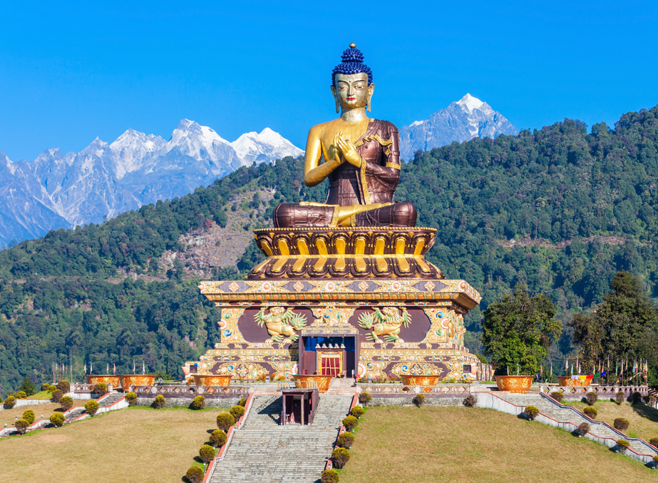
Tour Overview
Destination: Sikkim – Gangtok – Lachung – Yumthang Valley – Pelling – Darjeeling
Duration: 13 Days
Departure: Balotra
Nature: Educational Tour

Slide 3
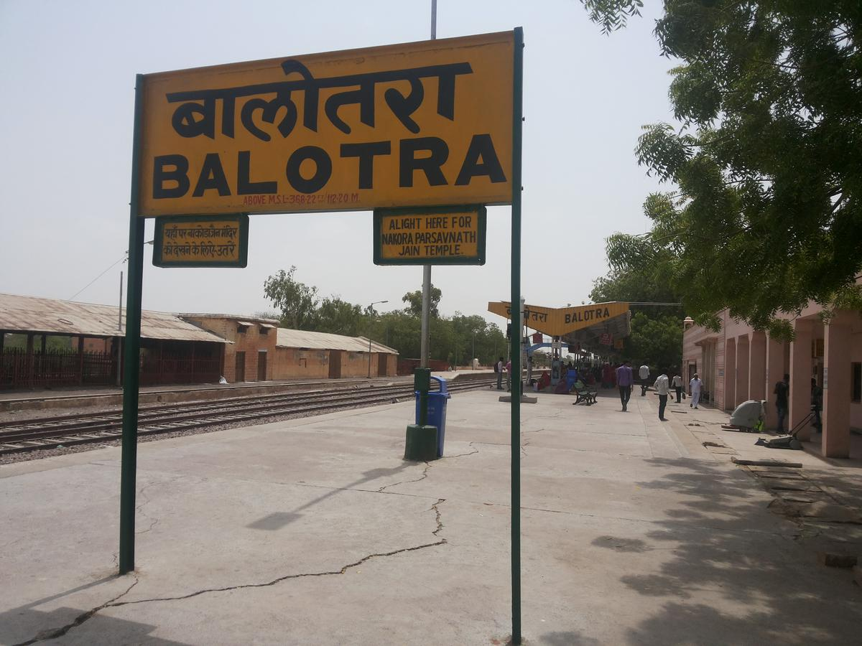
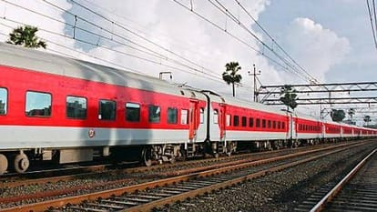
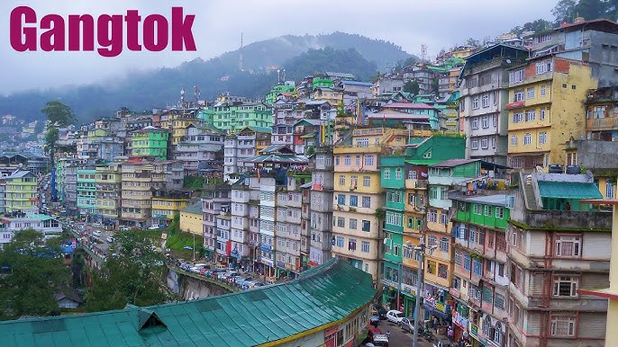
Day 1 (Monday)
Departure from Balotra by train.
Meals provided
Overnight journey.
Day 2 (Tuesday)
Train journey continues.
All meals in train.
Day 3 (Wednesday)
Arrival at NJP / Bagdogra.
Transfer to Gangtok.
Hotel check-in & rest.

Slide 4
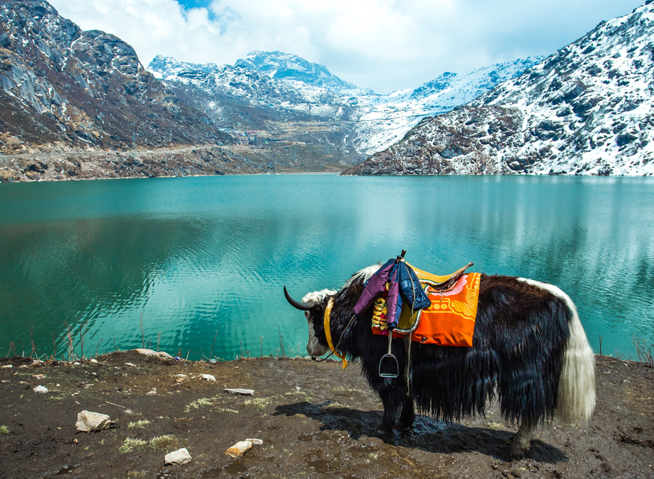
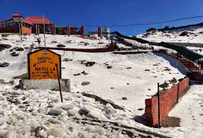
Day 4 (Thursday)
Excursion to Tsomgo Lake, Baba Mandir & Nathula Pass.

Slide 5
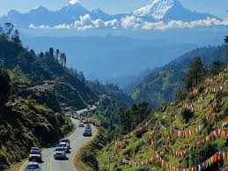
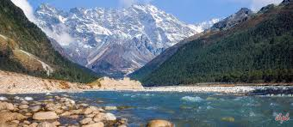
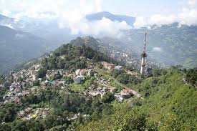
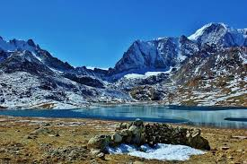
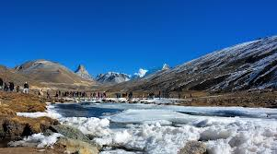
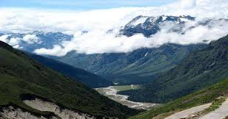
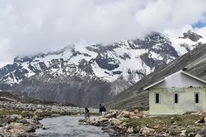
Day 5 (Friday)
Travel Gangtok to Lachung.
Scenic mountain drive.
Day 6 (Saturday)
Visit Yumthang Valley & Zero Point.
Return to Lachung.

Slide 6
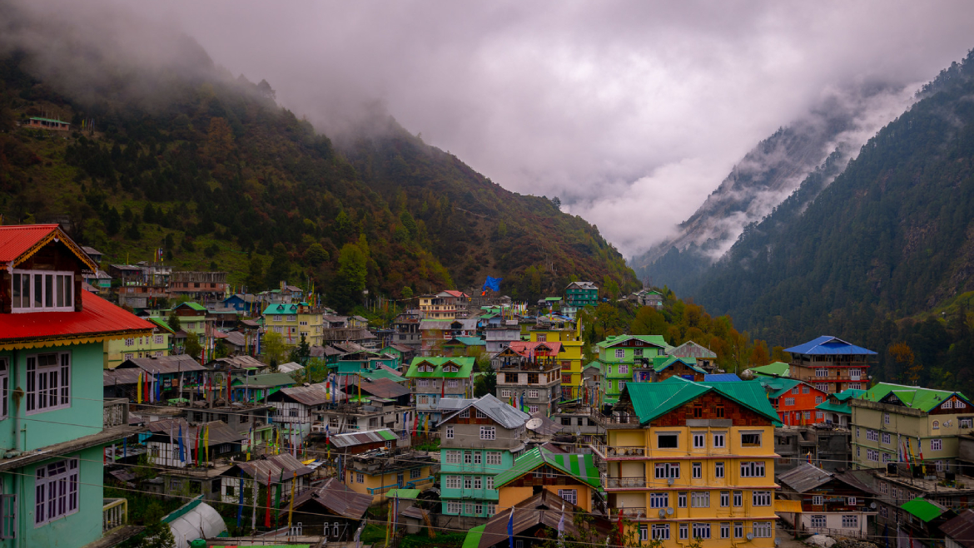
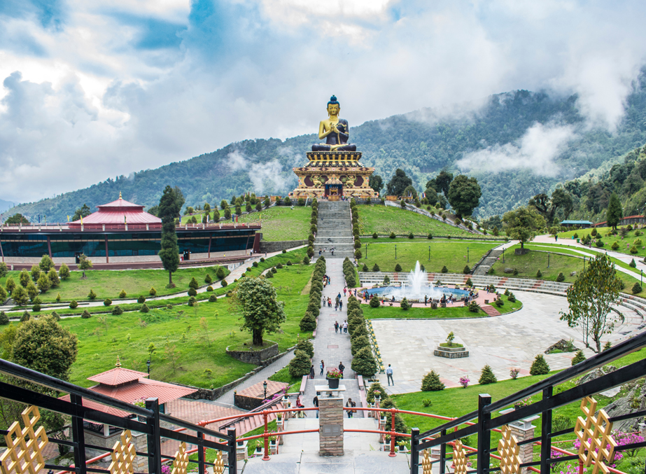
Day 7 (Sunday)
Return from Lachung to Gangtok.
Rest.
Day 8 (Monday)
Travel Gangtok to Pelling via Namchi

Slide 7
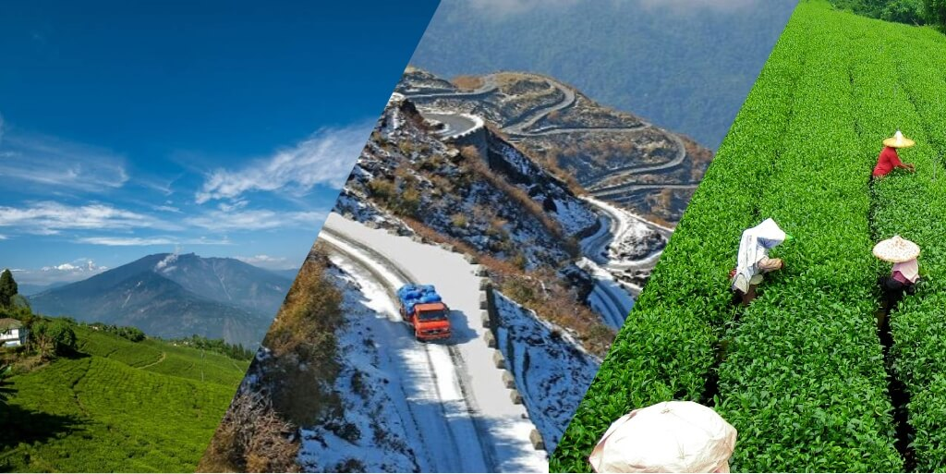
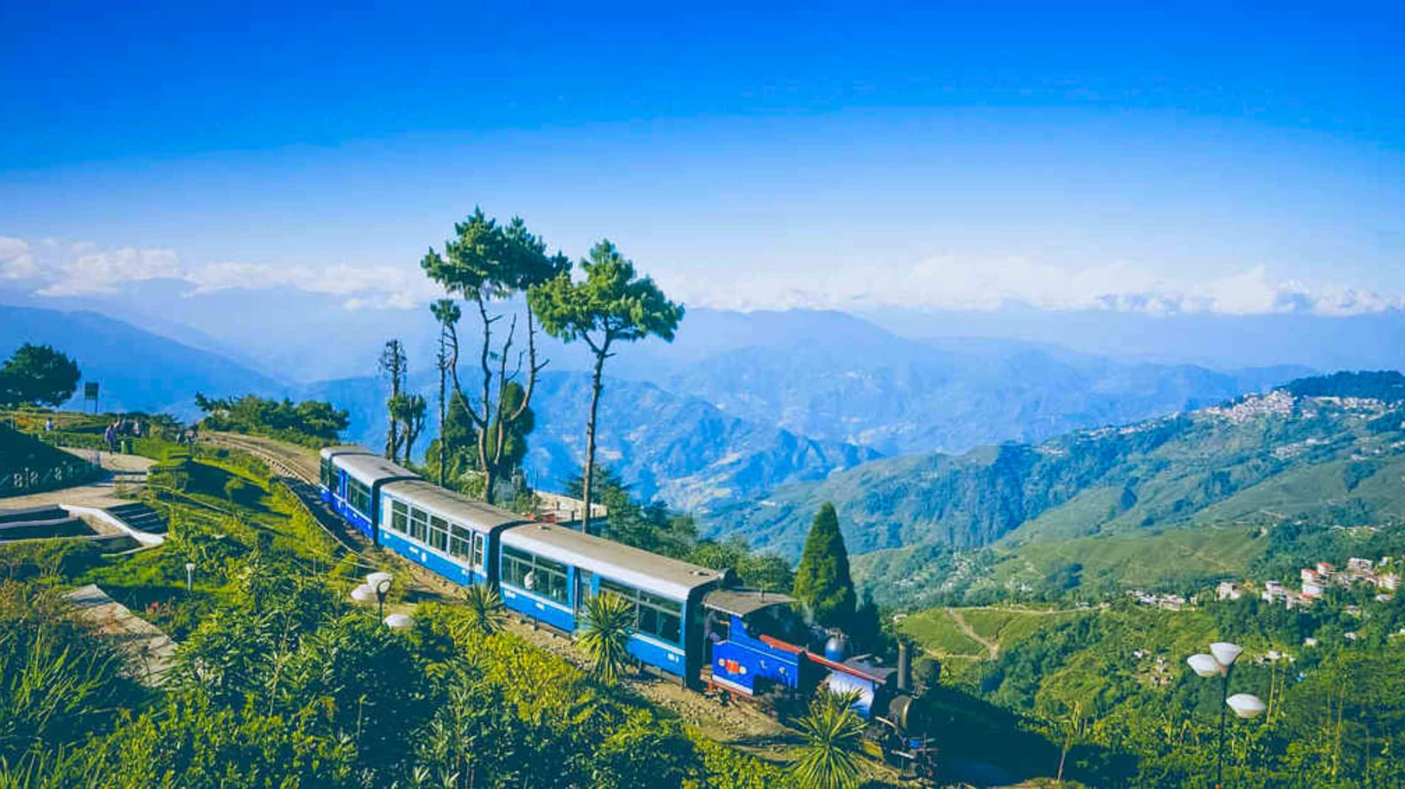
Day 9 (Tuesday)
Pelling sightseeing.
Proceed to Darjeeling
Day 10 (Wednesday)
Full day Darjeeling sightseeing.

Slide 8
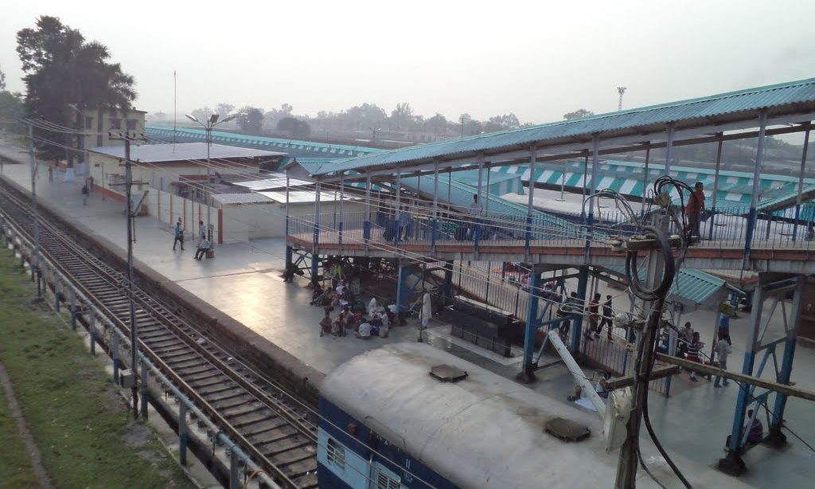
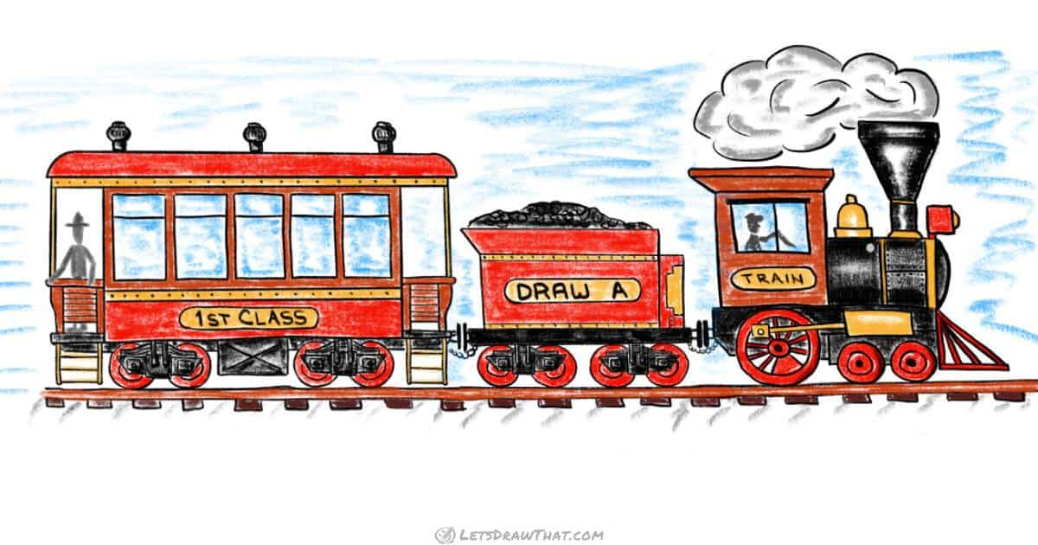
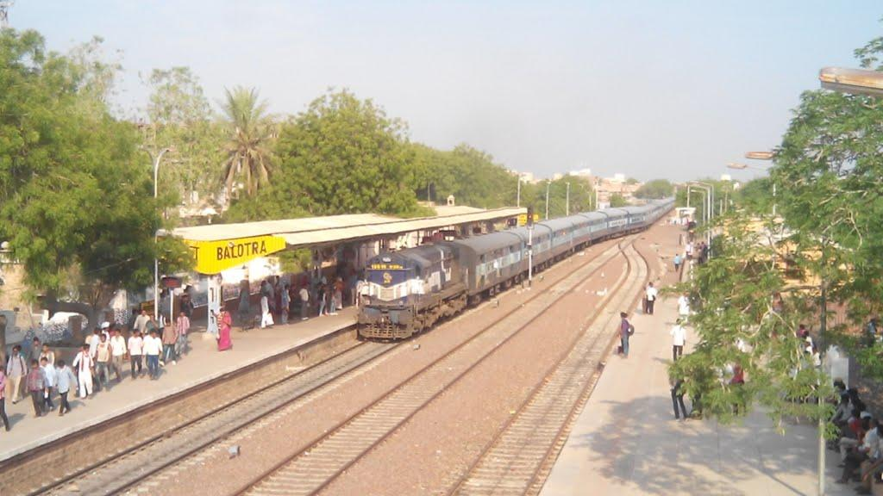
Day 11 (Thursday)
Drop at NJP & return train.
Packed meals.
Day 12 (Friday)
Train journey continues.
Day 13 (Saturday)
Arrival at Balotra.
Tour Concludes.

